Slide 1

HDR Video Reconstruction
Review 2: Project Presentation
EE5176 Project
Shital (EE20S052) | Rahul (EE20S136) | Shrisudhan (ME17B122)

Slide 2
Overall Problem Statement
Implementing an algorithm to reconstruct High Dynamic Range(HDR) video from coded exposure frames designed by exploiting temporal and spatial information from the video frames.
Task-2 Problem Statement
Reconstruct HDR frames from coded exposure frames generated using bayer-filter.
Apply Super-Resolution to restore the full-resolution frames.
Generate coded exposure frames by exploiting temporal information from the previous frames.
Develop a encoder-decoder network for HDR reconstruction.

Slide 3
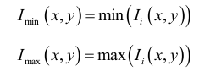
LDR Image Generation - Algorithm
The generation of the LDR images with various exposures from a single HDR image can be improved by considering chrominance values.
From the input HDR image, I, we separate the chrominance value (cb, cr) using the rgb2ycbcr function. Create the minimum channel value image and maximum channel value image.
We take the chrominance value of I and use I_{min} as luminance to generate low exposure image and I_{max} to generate high exposure images.

Slide 4
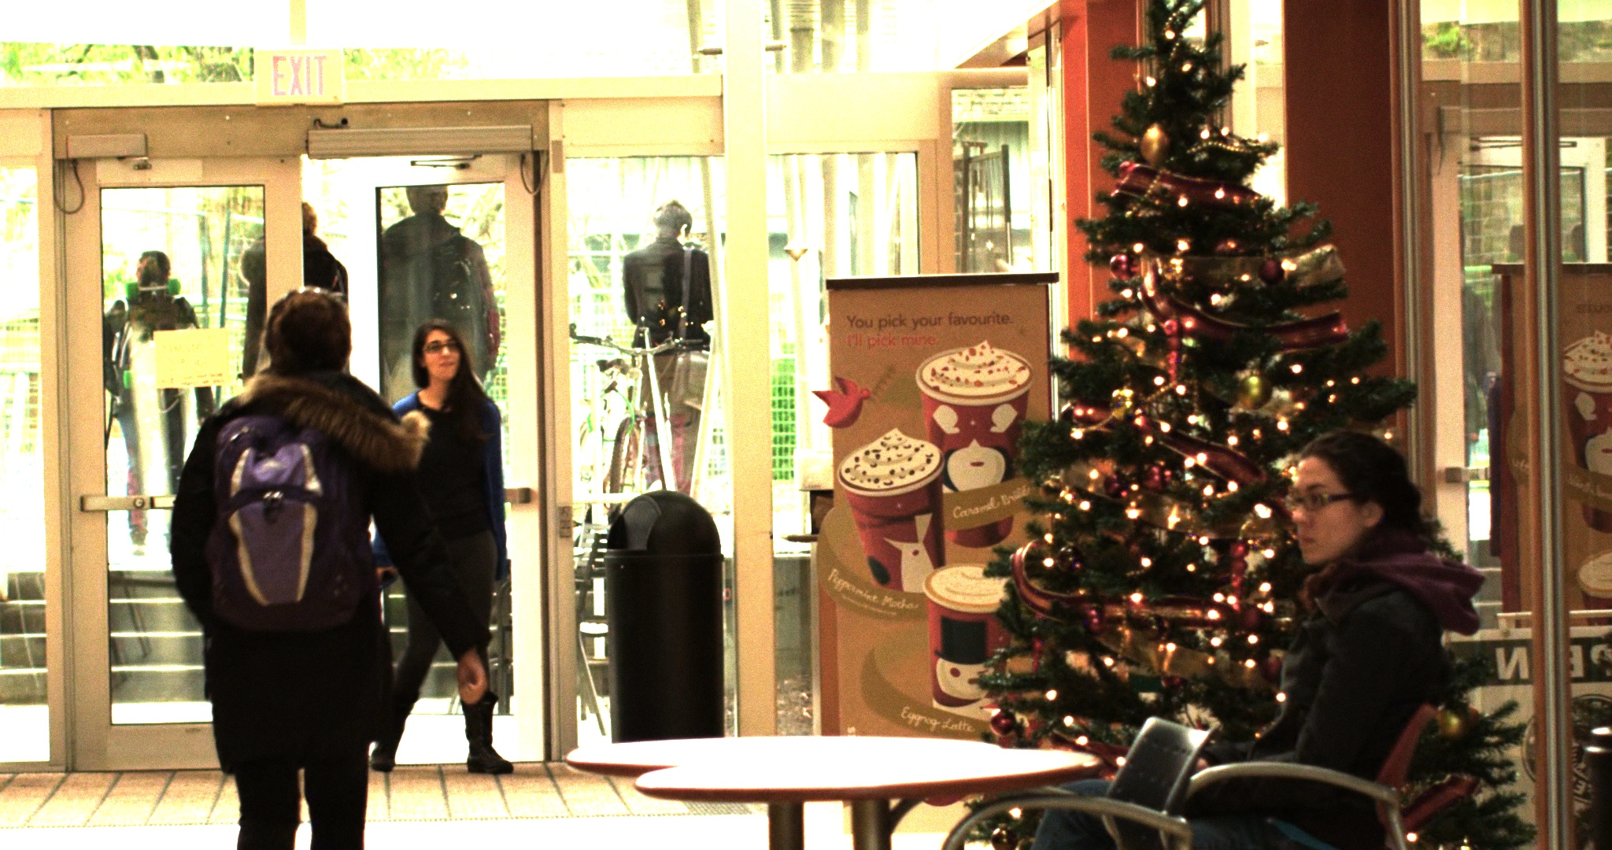
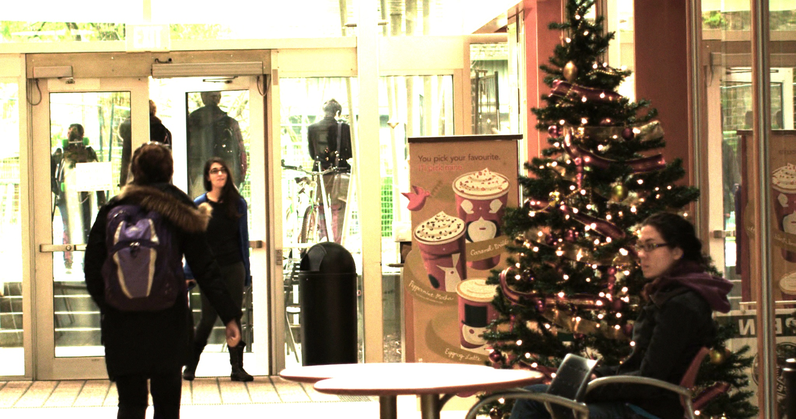
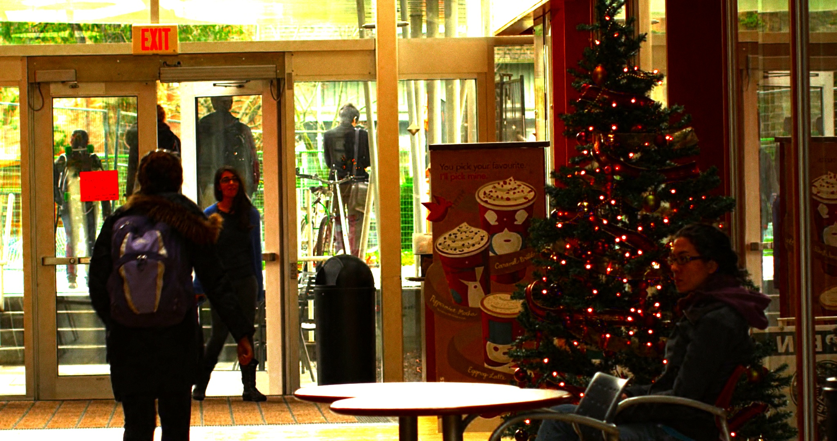
LDR Image Generation - Results
High exposure
High exposure
High exposure
Low exposure
Moderate exposure

Slide 5
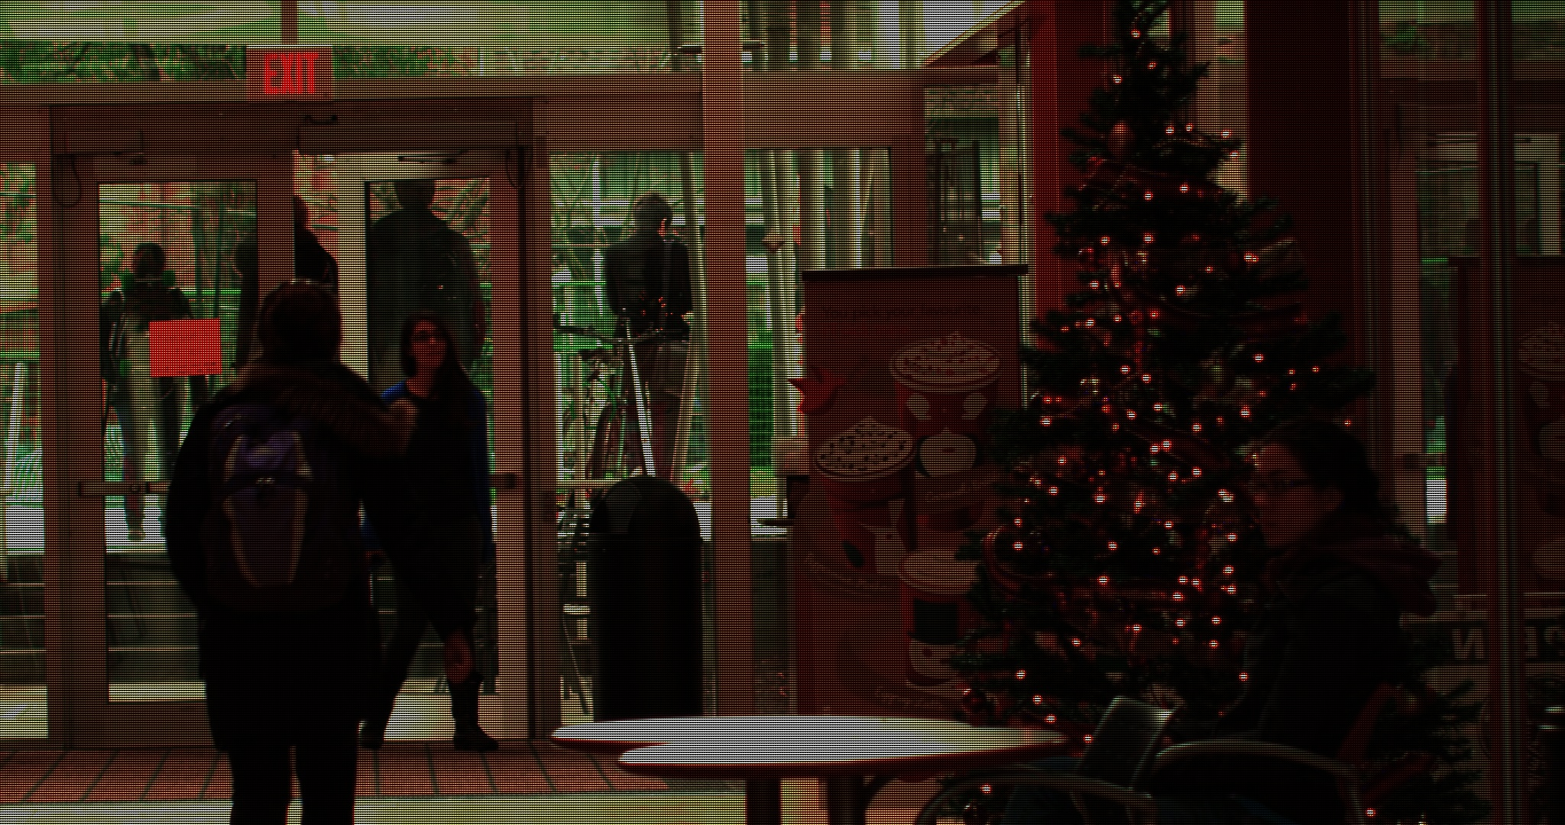
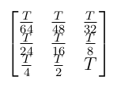
Coded Exposure Generation - Results

Slide 6
HDR Image Reconstruction - Algorithm
Now we have the coded exposure frame. To recover the corresponding clean HDR frame:
We extracted 9 low-resolution images with equal exposures, corresponding to T/32 ,T/16 etc.
Combined the 9 LDR images into one HDR image using Debevic's algorithm.
This gives us a low-resolution reconstructed HDR image.
To get back to the full resolution, deep learning based super resolution algorithm is applied to the HDR image generated previously.
Fast Super-Resolution Convolutional Neural Network(FSRCNN) model is used to directly upsample the image.

Slide 7
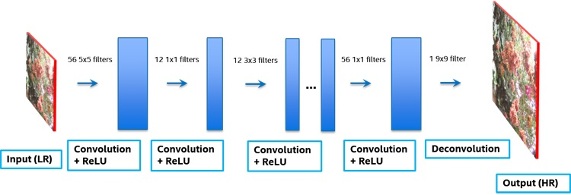
Super Resolution Network - Algorithm
FSRCNN:
Feature extraction: Extracts feature maps directly from the low resolution(LR) image.
Shrinking: Reduces dimension of feature vectors by using a smaller size for filters.
Non-linear mapping: Constructs feature map for high resolution(HR) images from extracted features of LR image.
Expanding: Increases dimension of feature vectors to reconstruct information.
Deconvolution: Performs upsampling and deconvolution to reconstruct the HR image.

Slide 8
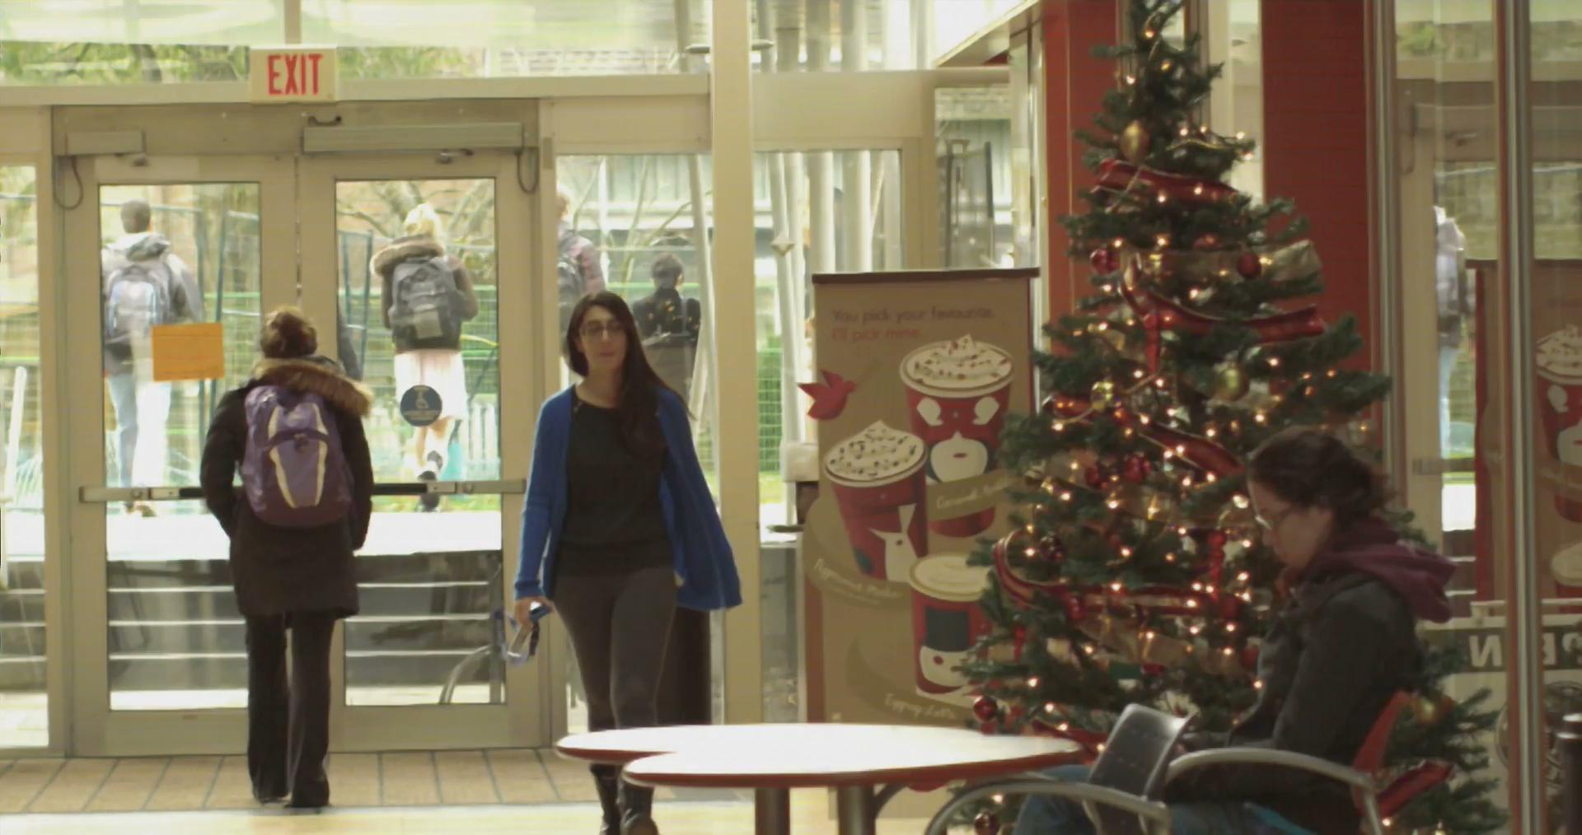
HDR Video - Results

Slide 9
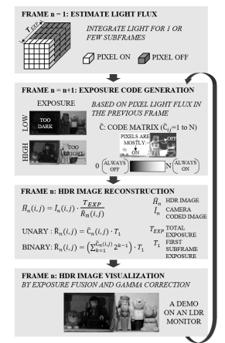
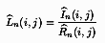
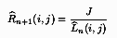
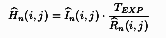
Scene-Aware Pixel-wise Adaptive Coded Exposure
The exposures of current frame is used to generate the exposure codes for the next frame.
Calculating normalization matrix:
Estimating the light flux of pixels:
Calculating next frame’s
normalization matrix
Reconstruction of HDR image:
Preparing coded exposure images like this will not lead to loss in resolution while reconstruction.

Slide 10
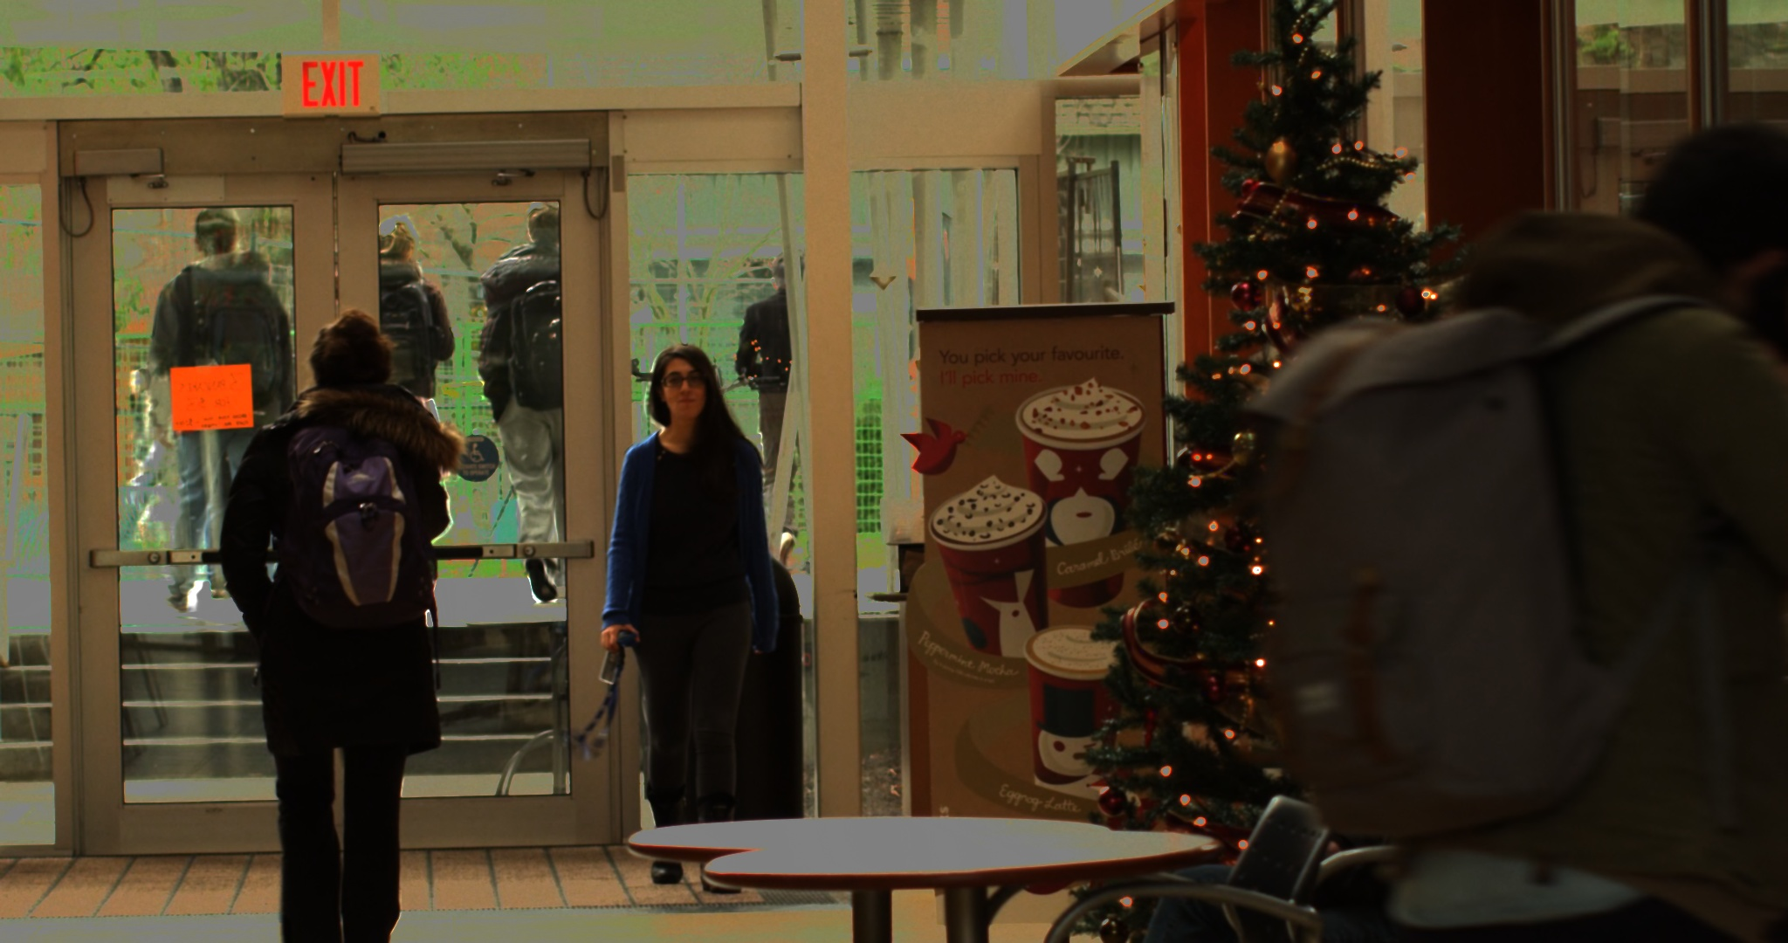
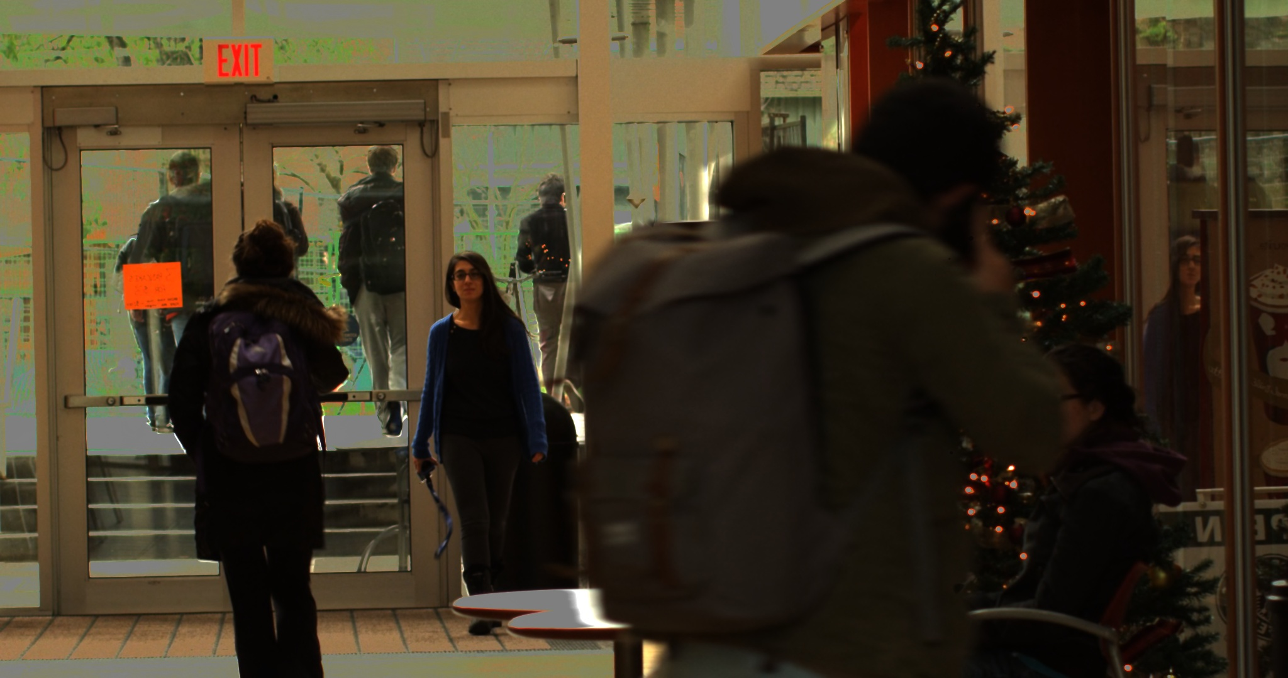
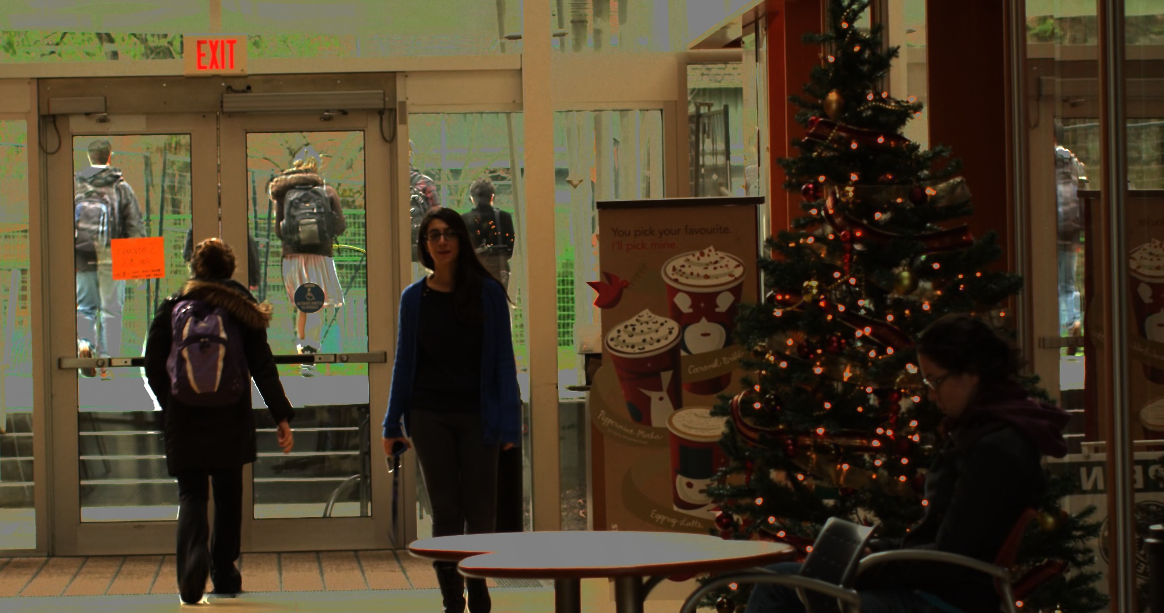
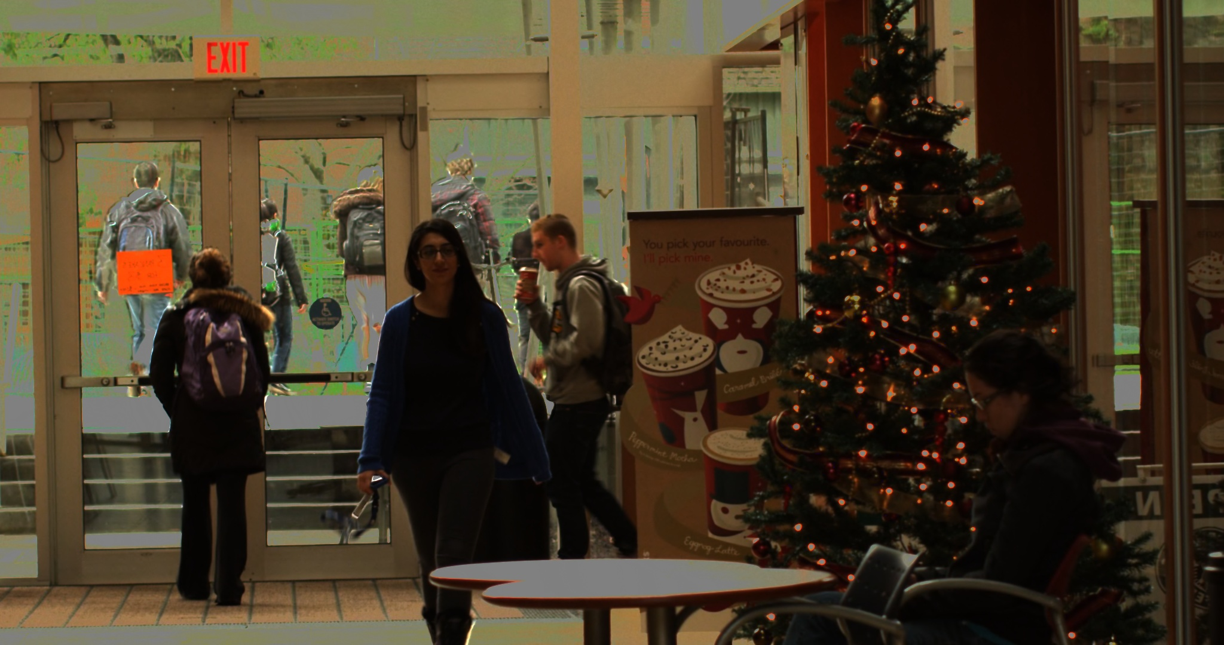
Pixel-wise Adaptive Coded Exposure - Results

Slide 11
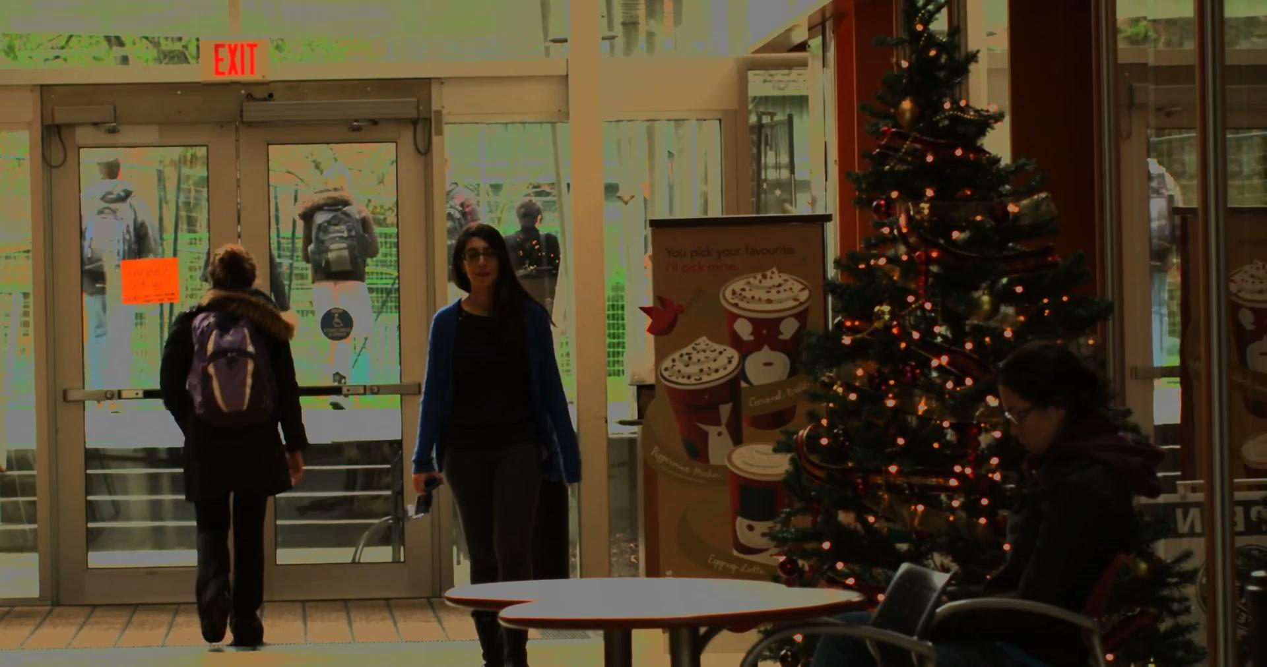
Pixel-wise Adaptive Coded Exposure - Camera Output

Slide 12
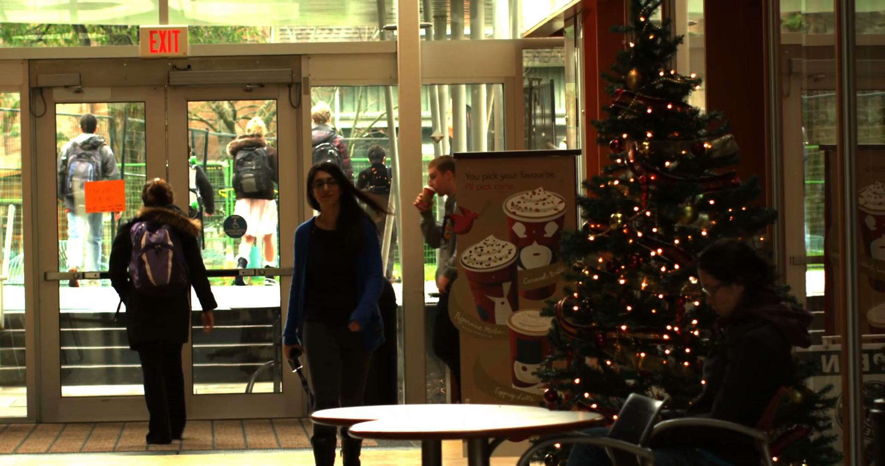
Pixel-wise Adaptive Coded Exposure - Results

Slide 13
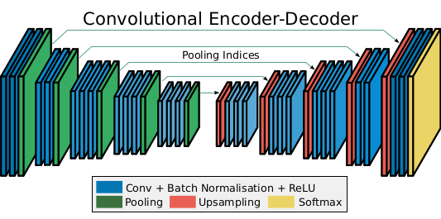
HDR Video Reconstruction using DNN
An encoder-decoder based network can be trained to reconstruct HDR frames from Coded Exposure frames given as inputs.
The SegNet model uses skipped connection between pooling and unpooling layers to avoid information loss in the unpooling layer.
A variation on SegNet with skipped connections and TSM module will be implemented.
SegNet

Slide 14
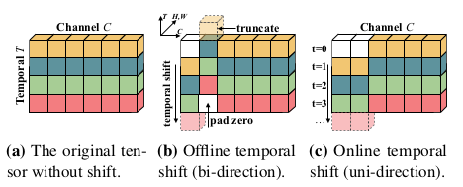
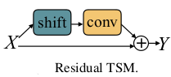
HDR Video Reconstruction using DNN
As observed in the Pixel-wise Adaptive Coded Exposure image, the estimation of movement of objects between consecutive frames would improve reconstruction performance.
The temporal information between frames can be combined using a Temporal Shift Module(TSM) which can be added with residual skip connections in the encoder network.

Slide 15
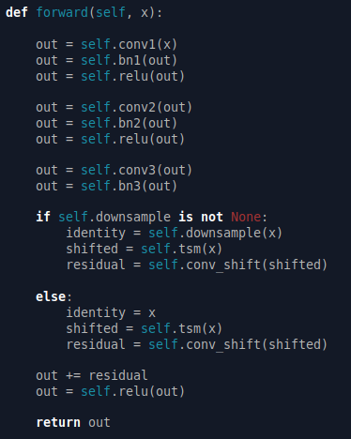
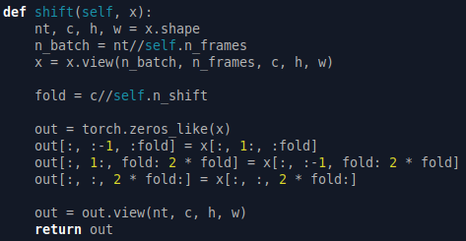
HDR Video Reconstruction using DNN - Code
TSM Module
Encoder’s block

Slide 16
Plans for next 2 weeks
Train the Encoder-Decoder network with a set of 5 successive Coded-Exposure image as input and HDR image as output.
Validate the Encoder-Decoder network with Coded-Exposure images.
Trying to develop an improved coded exposure image.

Slide 17
Individual Contributions
Shital Sheshrao Yelne
Code development for HDR video reconstruction and Super-Resolution.
Code development for Pixel wise adaptive coded exposure.
Rahul G S
Code development for LDR and Coded Exposure Image generation.
Code development for HDR video reconstruction and Super-Resolution.
Code development for Pixel wise adaptive coded exposure.
Shrisudhan G
Code development for LDR and Coded Exposure Image generation.
Code development for SegNet and TSM.

Slide 18
THANK
YOU

